Slide 1
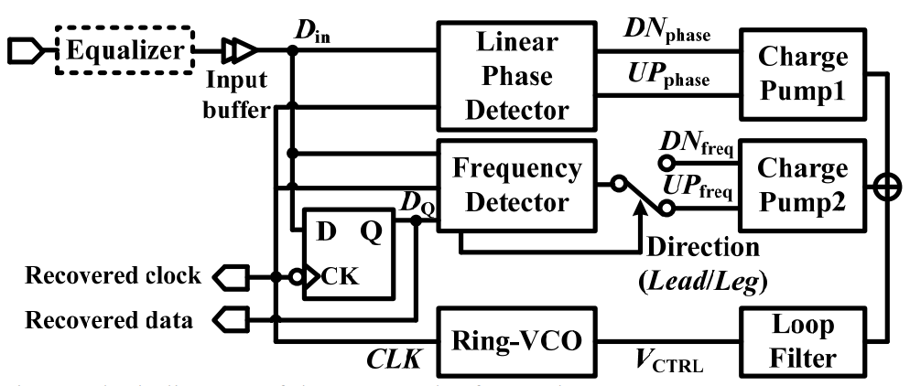
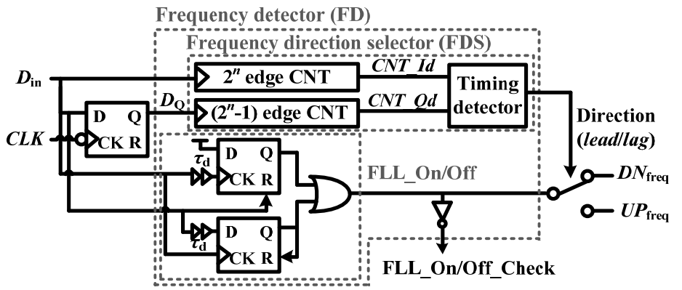
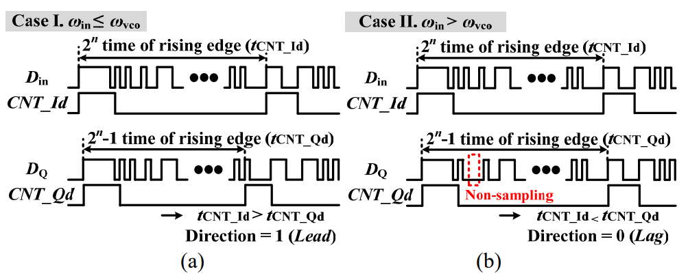
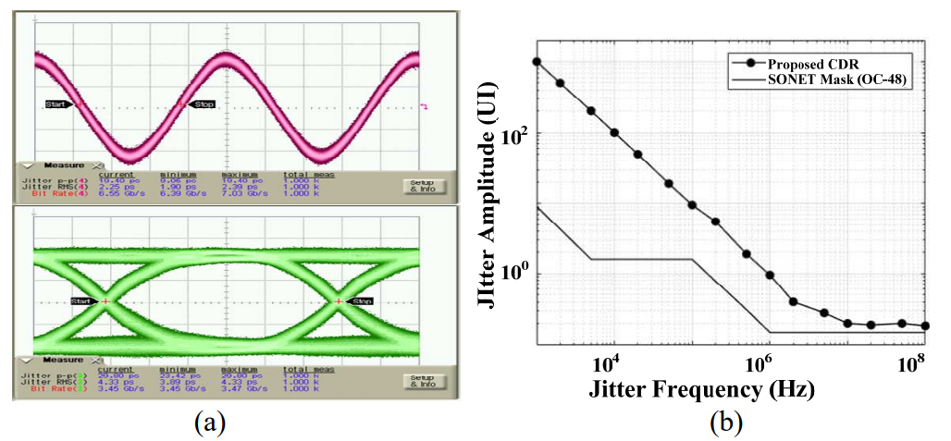
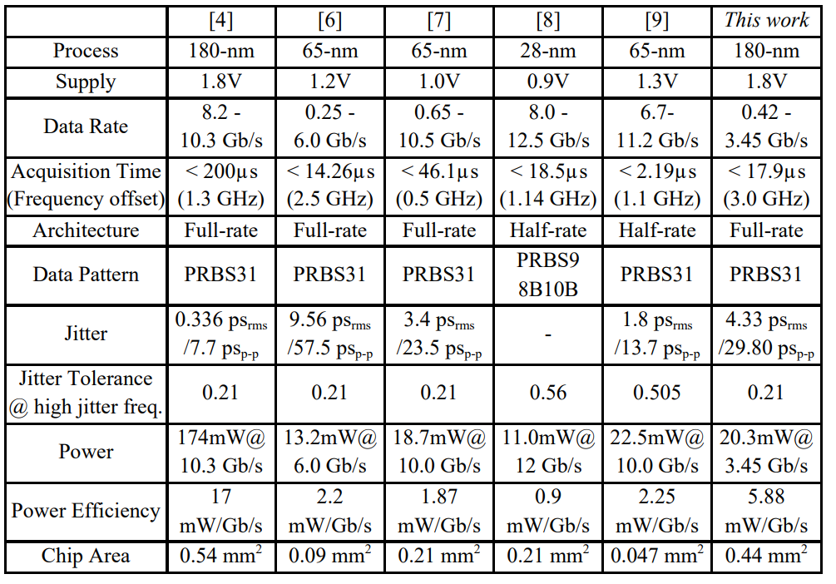
A 0.42 - 3.45 Gb/s Referenceless Clock and Data Recovery Circuit with Counter-based Unrestricted Frequency Acquisition
Kyungsub Son, Sanghun Baek and JinKu Kang
Dept. of Electronic Engineering, INHA University
Incheon, Republic of Korea
Abstract— A 0.42 to 3.45 Gb/s counter-based referenceless clock and data recovery (CDR) circuit that has an unrestricted and continuous-rate frequency acquisition capability is presented. The proposed frequency detector first selects a frequency driving direction of the recovered clock using counters and the frequency locking is achieved with the frequency driving direction plus phase information. After that, phase locking is done with the phase-locked loop. The CDR circuit occupied an area of 0.442 mm² using 180-nm CMOS process. Locking time less than 17.9 µs has been achieved from initially the highest data rate of 3.45 Gb/s to the lowest 0.42 Gb/s rate, and vice versa. The CDR circuit has shown 4.33 ps rms jitter in recovered data for a 3.45 Gb/s PRBS31 pattern. The power consumption is 20.3mW including I/O buffer at 3.45 Gb/s with a 1.8V supply.
1. Block diagram of the Proposed referenceless CDR
2. Block diagram of the proposed FD with the frequency direction selector.
The block diagram of the proposed referenceless CDR with counter-based frequency acquisition scheme is shown in Fig.1.
FDS generates the frequency driving direction (Lead or Lag), and the output of FD (UP_{freq} or DN_{freq}) is proportional to frequency difference between input data (D_{in}) and VCO clock (CLK)
3. Operation of FDS: (A) timing diagram when CLK is leading, and (b) timing diagram when CLK is lagging.
4. Measured (a) eye diagram of recovered data, recovered clock, and (b) jitter tolerance of the CDR at 3.45 Gb/s with a single tone jitter at BER 10⁻¹²
5. Microphotograph of the Chip
6. Performance Summary
0.34
0.32
3.4
Acknowledgment - The chip fabrication and EDA tool were supported by the IC Design Education Center(IDEC), Korea.

